Slide 1
Introduction to
STRUCTURED QUERY LANGUAGE
Part-II
BY:
IFFAT FARZANA ANJUM
DBS
IIUI

Slide 2
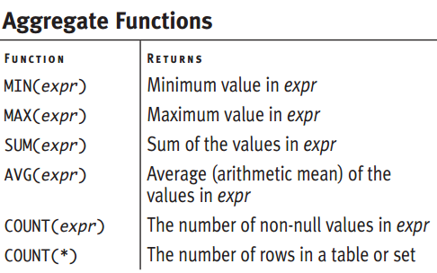
Summarizing and Grouping Data
SQL’s aggregate functions, or set functions, are which operate on a group of values to produce a single, summarizing value.
You apply an aggregate to a set of rows, which can be:
◆ All the rows in a table
◆ Only those rows specified by a WHERE clause
◆ Those rows created by a GROUP BY clause
No matter how many rows the input set contains, an aggregate function returns a
single statistic: a sum, minimum, or average, for example.
Notes:
This chapter introduces SQL’s aggregate functions, or set functions, which operate on a group of values to produce a single, summarizing value.
You apply an aggregate to a set of rows, which can be:
◆ All the rows in a table
◆ Only those rows specified by a WHERE clause
◆ Those rows created by a GROUP BY clause

Slide 3
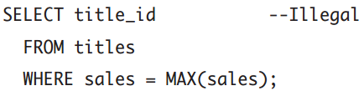

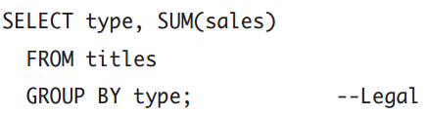
Creating Aggregate Expressions
Aggregate functions can be tricky to use. This section explains what’s legal and
what’s not.
An aggregate expression can’t appear in a WHERE clause.
You can’t mix nonaggregate (row-by-row) and aggregate expressions in a SELECT
clause.
  A SELECT clause must contain either all nonaggregate expressions or all aggregate expressions.
The one exception to this rule is that you can mix nonaggregate and aggregate
expressions for grouping columns

Slide 4


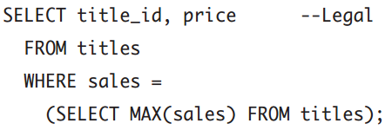
Creating Aggregate Expressions
You can use more than one aggregate expression in a SELECT clause:
You can’t nest aggregate functions:
You can use aggregate expressions in subqueries.
You can’t use subqueries in aggregate expressions: AVG(SELECT price FROM titles) is illegal.

Slide 5
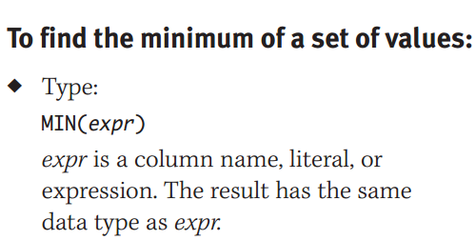
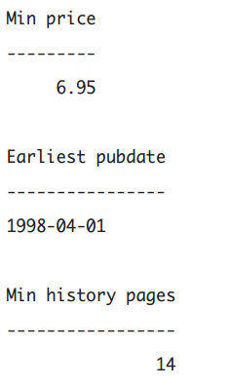
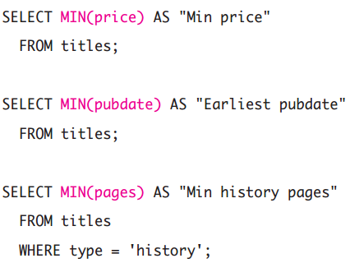
Finding a Minimum with MIN()

Slide 6
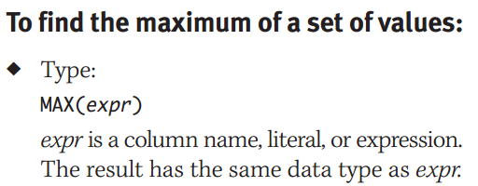
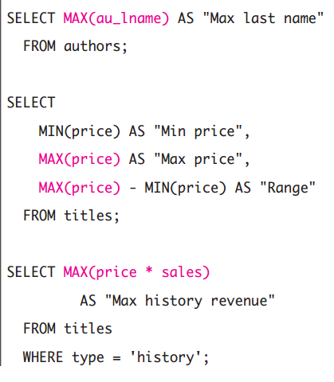
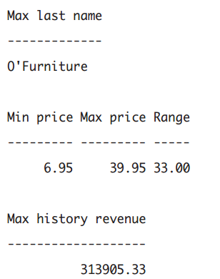
Finding a Maximum with MAX()

Slide 7
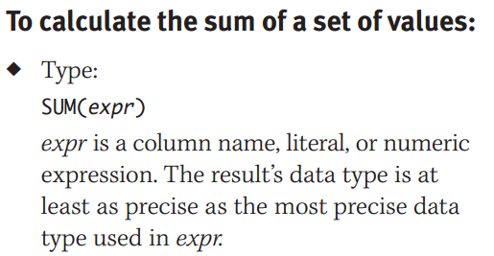
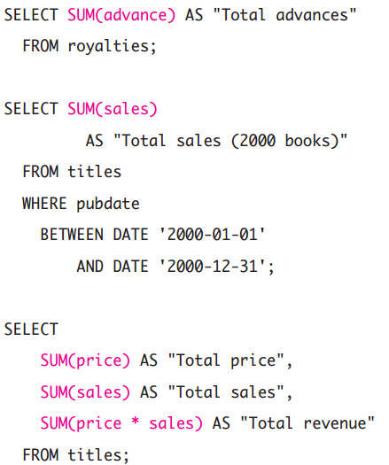
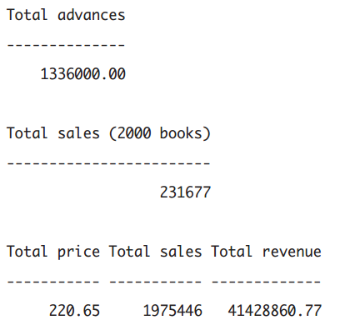
Calculating a Sum with SUM()

Slide 8
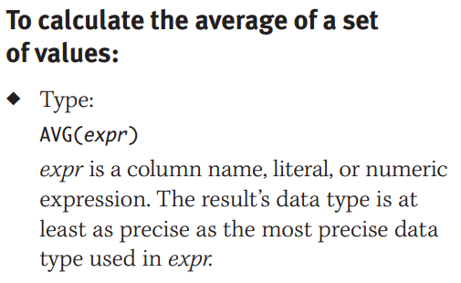
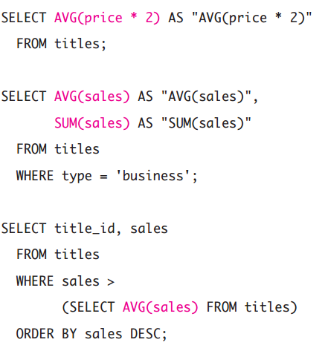
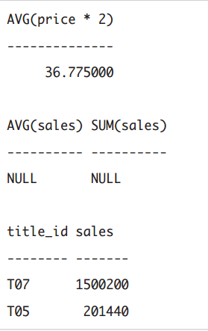
Calculating an Average with AVG()

Slide 9
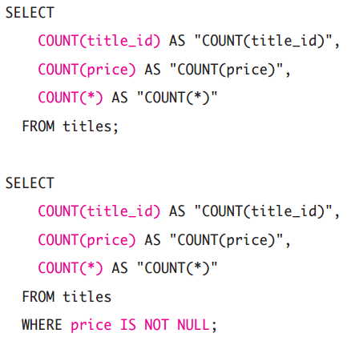
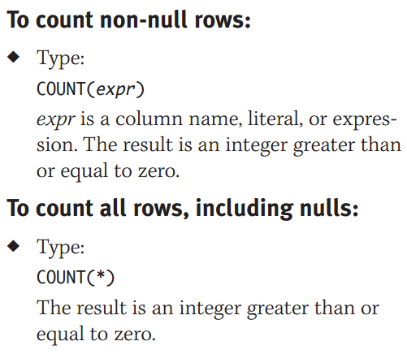
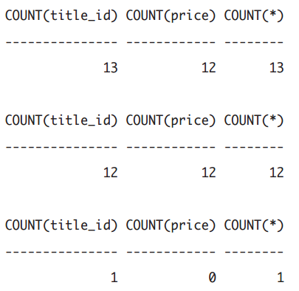
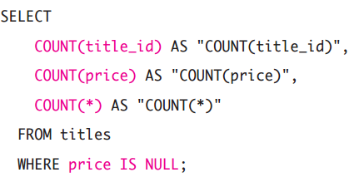
Counting Rows with COUNT()

Slide 10
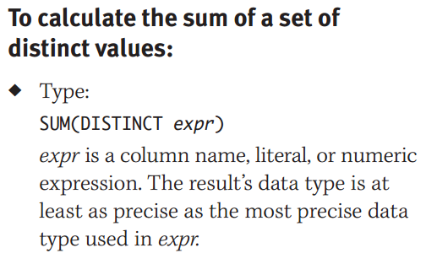
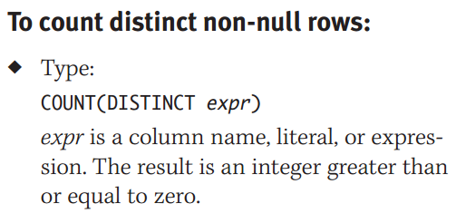
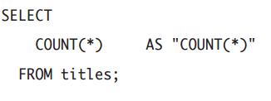
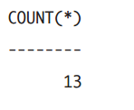
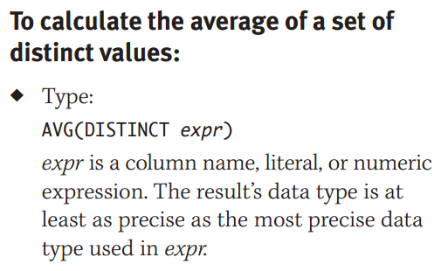
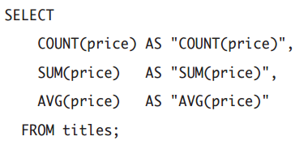
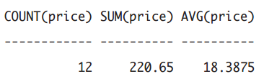
Aggregating Distinct Values with DISTINCT

Slide 11
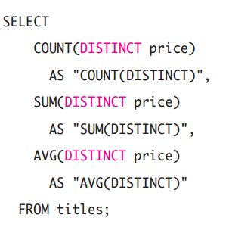
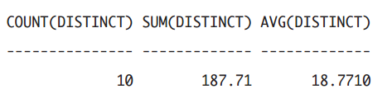

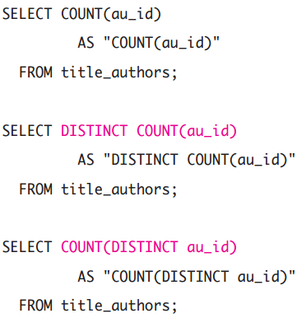
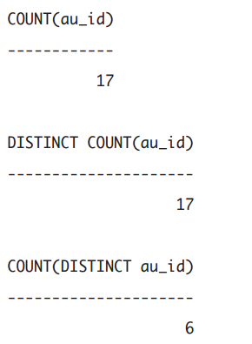
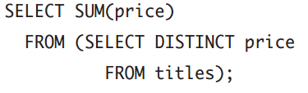
Aggregating Distinct Values with DISTINCT
Microsoft Access

Slide 12
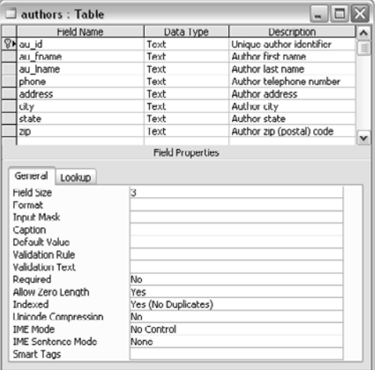
Displaying Table Definitions
To use INSERT, UPDATE, or DELETE, you must know about the columns of the table whose
data you’re modifying, including:
◆ The order of the columns in the table
◆ Each column’s name
◆ Each column’s data type
◆ Whether a column is a key (or part of a key)
◆ Whether a column’s values must be unique within that column
◆ Whether a column allows nulls
◆ Each column’s default value (if any)
◆ Table and column contstraints

Slide 13
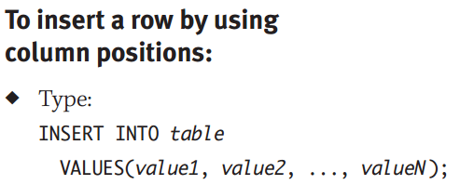
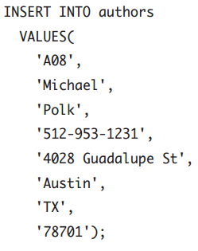
Inserting Rows with INSERT
The INSERT statement adds new rows to a table.
Insert a row by using column positions (INSERT VALUES)
Insert a row by using column names (INSERT VALUES)
Insert rows from one table into another table (INSERT SELECT)
This INSERT statement adds a new row to the table authors by listing values in the same order in which the columns appear in authors.

Slide 14
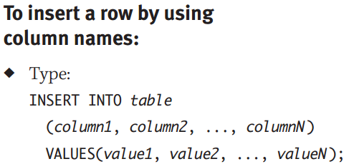
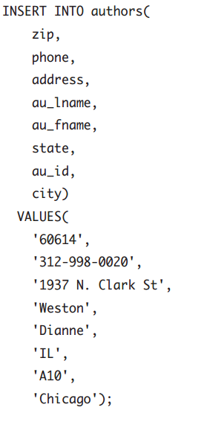
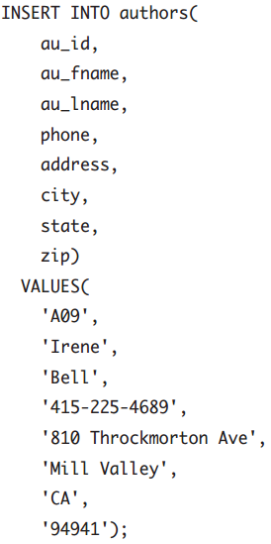
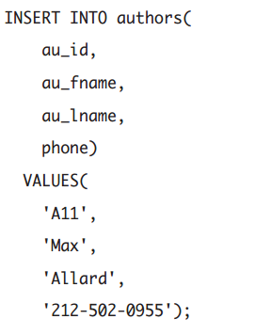
Here, I’ve added a row for a new author but omitted column names and values for the author’s address information. The DBMS inserts nulls into the omitted columns automatically
This INSERT statement adds a new row to the table authors by listing values in the same order in which the column names appear in the column list.

Slide 15
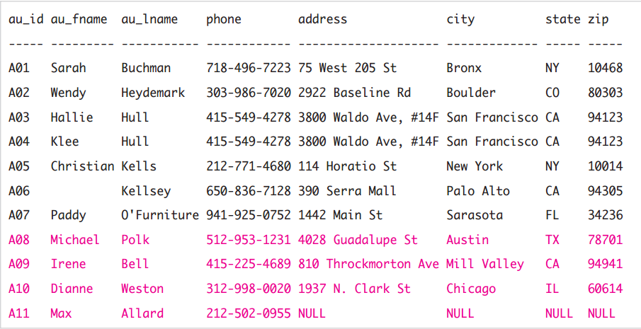
The table authors has four new rows after I run the above SQL commands

Slide 16
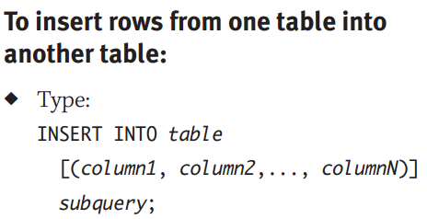
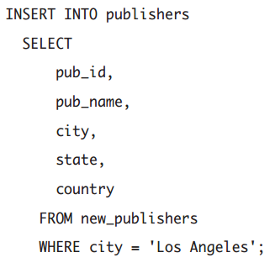

Insert the rows for Los Angeles–based publishers from new_publishers into publishers
This table, named new_publishers, is used for queries

Slide 17
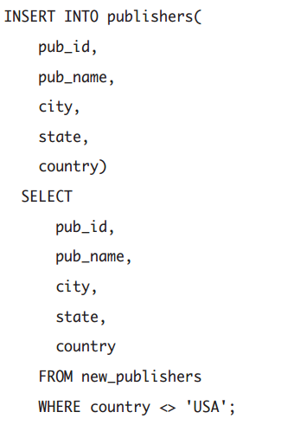
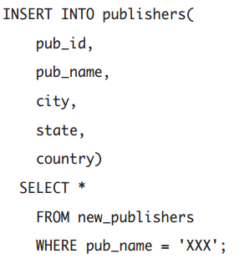
Insert the rows for publishers named XXX
from new_publishers into publishers.
Insert the rows for non-U.S. publishers
from new_publishers into publishers.

Slide 18
